Slide 1
Join:
Use to combine rows from one or more tables, based on a related column between them.
Example
Orders table
Customers table
OrderID | CustomerID | OrderDate
10308 | 2 | 1996-09-18
10309 | 37 | 1996-09-19
10310 | 77 | 1996-09-20
CustomerID | CustomerName | ContactName | Country
1 | Alfreds Futterkiste | Maria Anders | Germany
2 | Ana Trujillo | Ana Trujillo | Mexico
3 | Antonio Moreno | Antonio Moreno | Mexico
The relationship between two tables
Apply below SQL statement:
SELECT Orders.OrderID, Customers.CustomerName, Orders.OrderDate FROM Orders INNER JOIN Customers ON Orders.CustomerID=Customers.CustomerID;
Result table
OrderID | CustomerName | OrderDate
10308 | Ana Trujillo | 9/18/1996

Slide 2

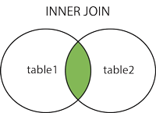
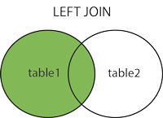
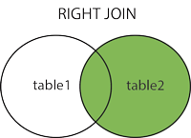
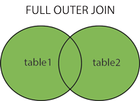
Different Types of SQL Joins:
(INNER) JOIN: Returns records that have matching values in both tables
LEFT (OUTER) JOIN: Returns all records from the left table, and the matched records from the right table
RIGHT (OUTER) JOIN: Returns all records from the right table, and the matched records from the left table
FULL (OUTER) JOIN: Returns all records when there is a match in either left or right table

Slide 3
Inner Join: selects records that have matching values in both tables.
SELECT column_name(s) FROM table1 INNER JOIN table2 ON table1.column_name = table2.column_name
Left Join: return all records from left table (table1), and the matching records from right table (table2). The result is 0 records from the right side, if there is no match.
SELECT column_name(s) FROM table1 LEFT JOIN table2 ON table1.column_name = table2.column_name;
Right Join: return all records from right table (table2), and the matching records from the left table (table1). The result is 0 records from the left side, if there is no match.
SELECT column_name(s) FROM table1 RIGHT JOIN table2 ON table1.column_name = table2.column_name;
Full Join: returns all records when there is a match in left (table1) or right (table2) table records.
SELECT column_name(s) FROM table1 FULL OUTER JOIN table2 ON table1.column_name = table2.column_name WHERE condition;
Note: Chúng ta đéo có full join trong MySQL ☺ nên nếu các bạn muốn fullHD thì hãy dung Union hoặc Union all hoặc cross join như bên dưới.
Cross Join: returns all records from both tables (table1 and table2).
SELECT column_name(s) FROM table1 CROSS JOIN table2;
Note: Hơi khó hiểu nên hỏi lại

Slide 4
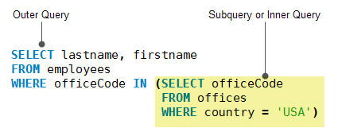
Self Join: is a regular, but the table is joined with itself.
SELECT column_name(s) FROM table1 T1, table1 T2 WHERE condition;
Join three tables:
SELECT column_name(s) FROM ((table1 T1 INNER JOIN table1 T2 ON condition) INNER JOIN table1 T3 ON condition);
Subquery:
A MySQL subquery is a query nested within another query such as SELECT, INSERT, UPDATE or DELETE. Also, a subquery can be nested within another subquery.
A MySQL subquery is called an inner query while the query that contains the subquery is called an outer query.
A subquery can be used anywhere that expression is used and must be closed in parentheses.
Example
Subquery types: check in sql script

Slide 5
Common Table Expression (CTE):
In MySQL, it is a temporary result set has a range within a single SQL statement.
CTE can be referenced any place within that statement multiples times
Use ‘With’ clause to define a CTE
CTE is always use with Select, Insert, Update or Delete
CTE is similar in function and scope to a derived table in SQL
Syntax:
with cte_name (column_names) as (query);

